Slide 1
Lab Warm-up
Cross-sectional Studies I
Notes:
This week, try in Google Slides with Poll Everywhere instead of Soctrative. See if you like it or now. If not, it should be fairly easy to copy and paste over to Socrative.

Slide 2
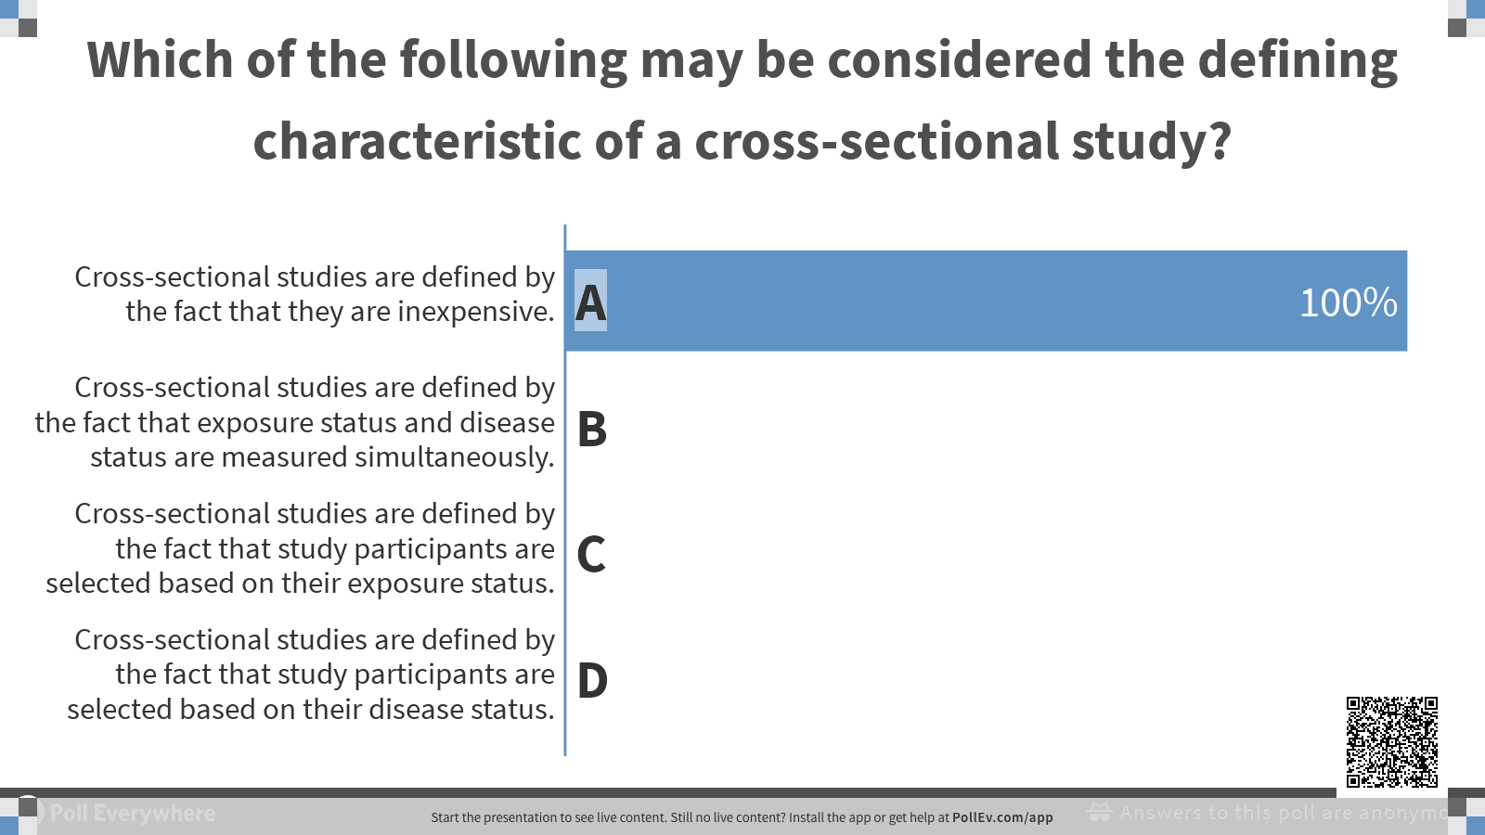
Notes:
Cross-sectional studies are basically defined by the fact that exposure and outcome are measured at the same time.

Slide 3
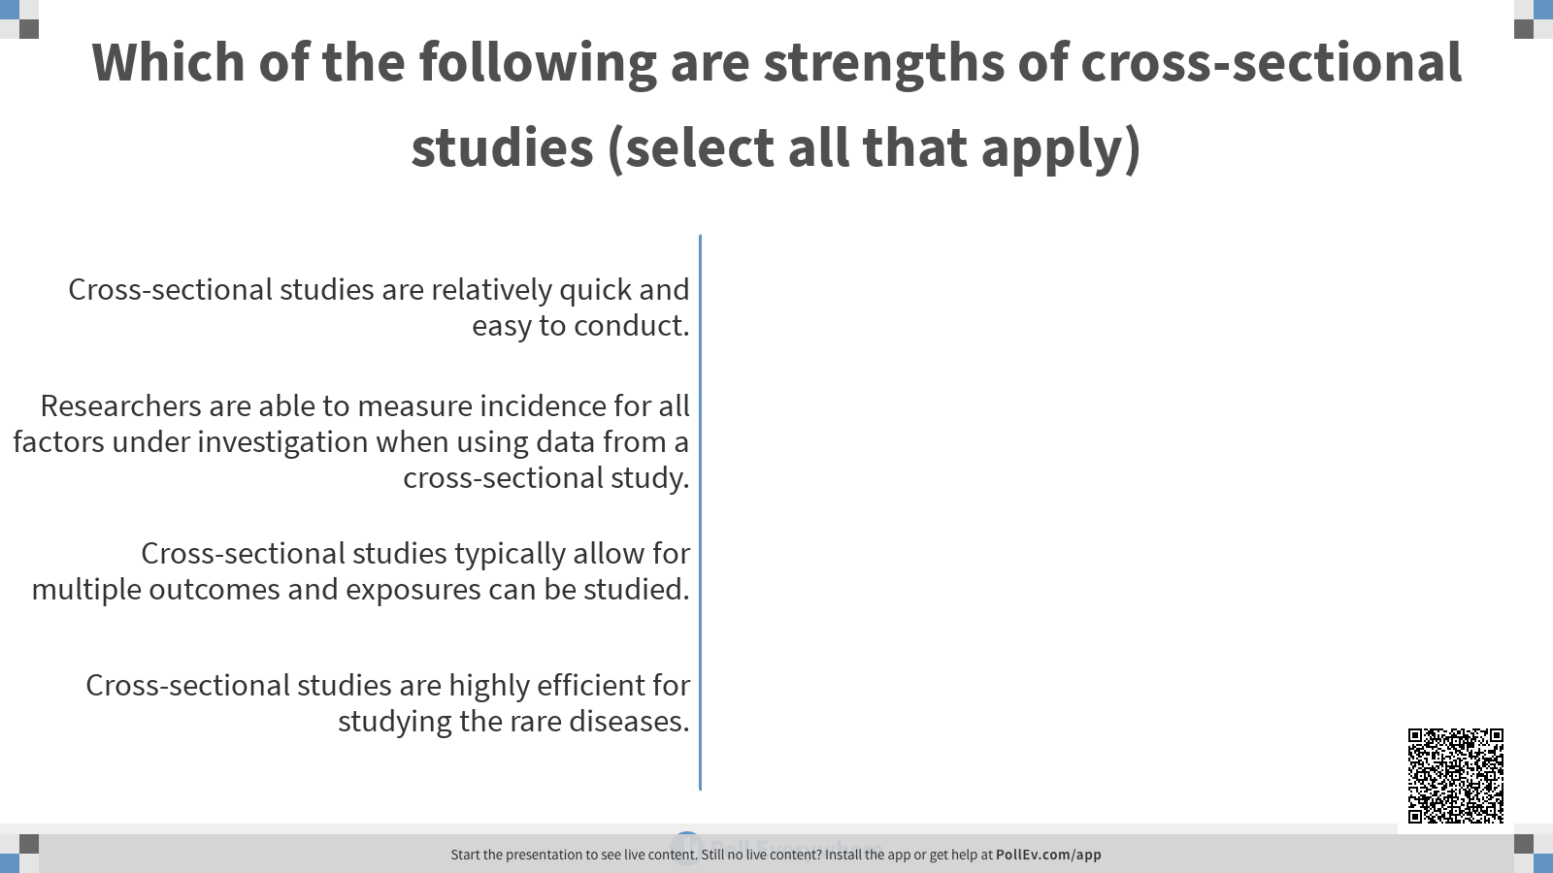
Notes:
Compared to other study designs, cross-sectional studies are relatively quick and easy to conduct.
Researchers are NOT able to directly measure incidence for all factors under investigation when using data from a cross-sectional study. They are typically able to directly measure prevalence.
Cross-sectional studies typically allow for multiple outcomes and exposures can be studied.
Cross-sectional studies are NOT highly efficient for studying the rare diseases. A population-based cross-section may yield very few cases when a disease is rare.

Slide 4
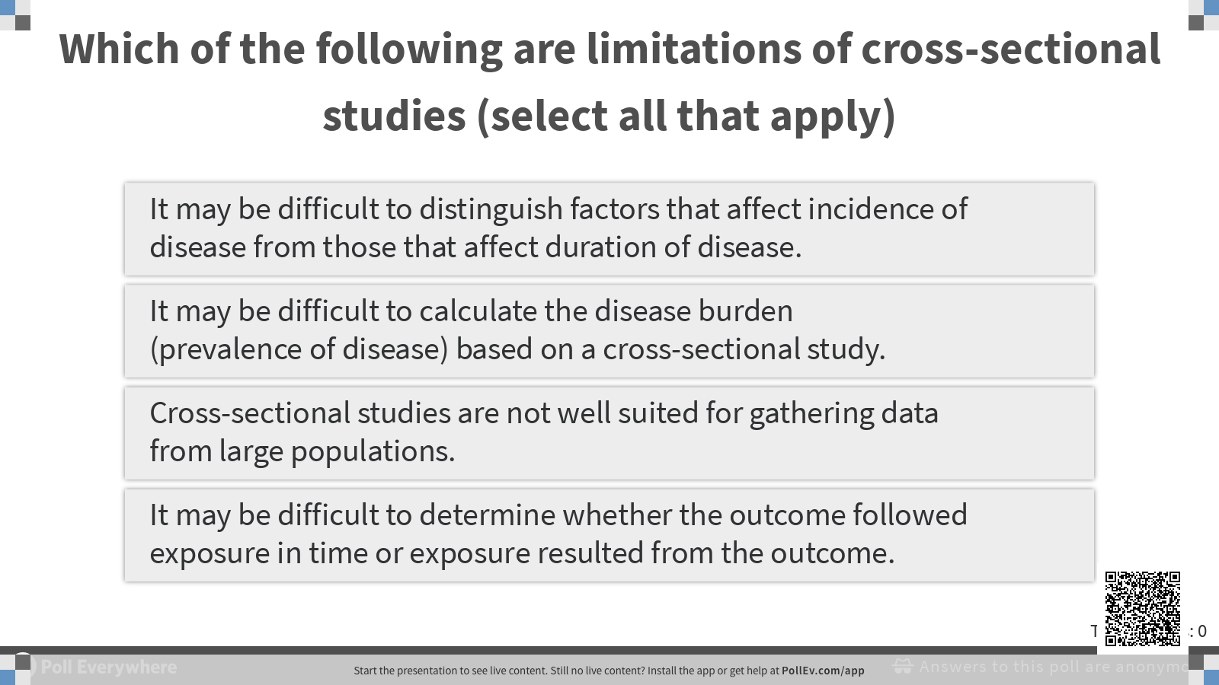

Slide 5
